Slide 1

Internet of Things and Big Data Analytics (IT4021)
Group Members:
H.R.T.V.Indrahenaka – IT19211824
J.M.S.A.Bandara – IT19167510
Panditharathne P.A.N.D - IT19157306
Wijesinghe W.M.A.B. - IT19241906

Slide 2
Project Description
This project is to develop an IoT system that is capable of Temperature monitoring.
Main Temperature monitoring sectors are,
Current Ambient Temperature
Past Temperature
Future Temperature(up to 12 months)
Temperature Values

Slide 3
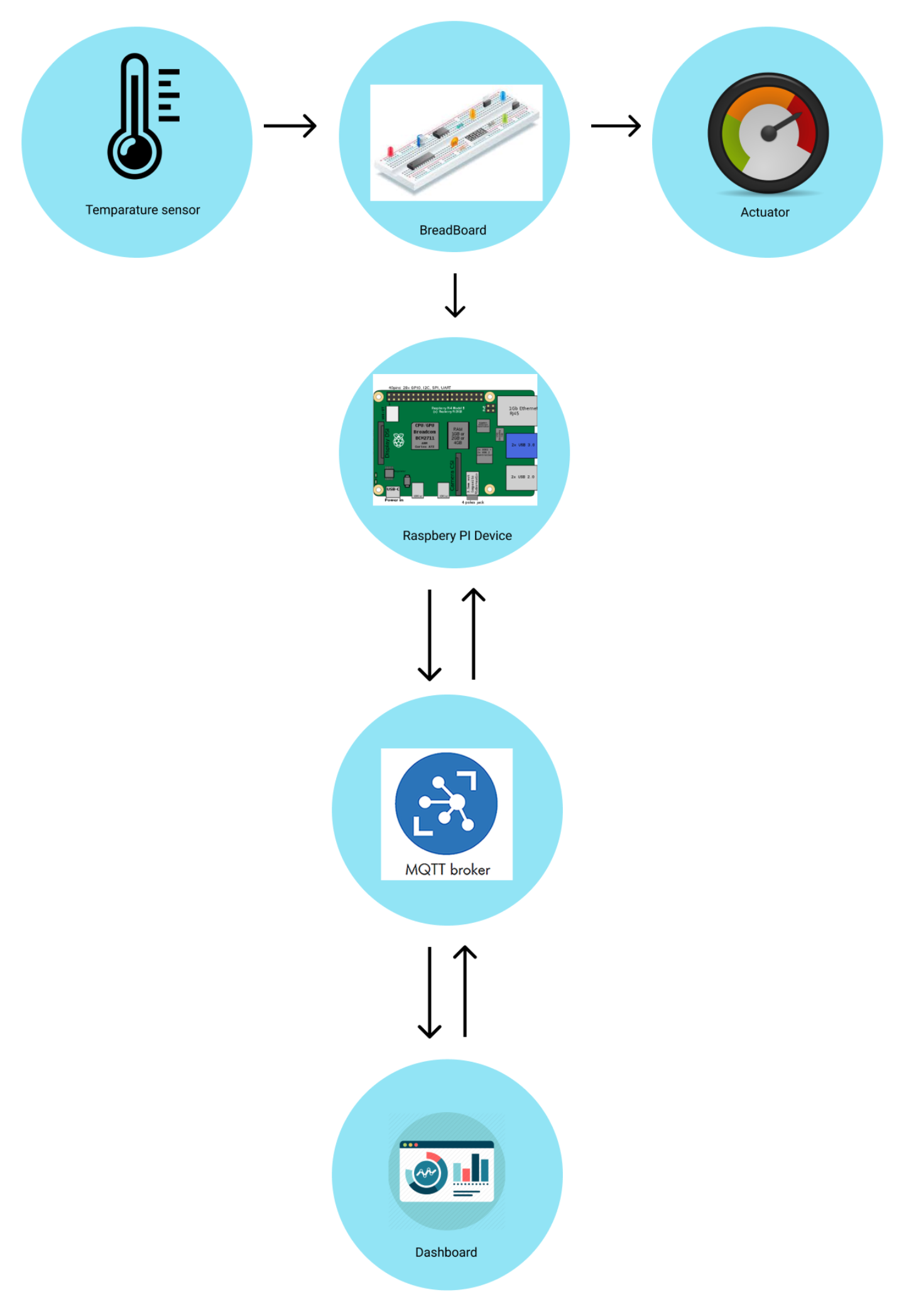
Overall Architecture

Slide 4
Hardware
Temperature Sensor – DHT11
Actuator – Servo Motor
Other required hardware –
RaspberryPi 4 Model
Jumper wires
Breadboard
Lan Cable
Type C power cable
32 Gb Class 10 SD card

Slide 5
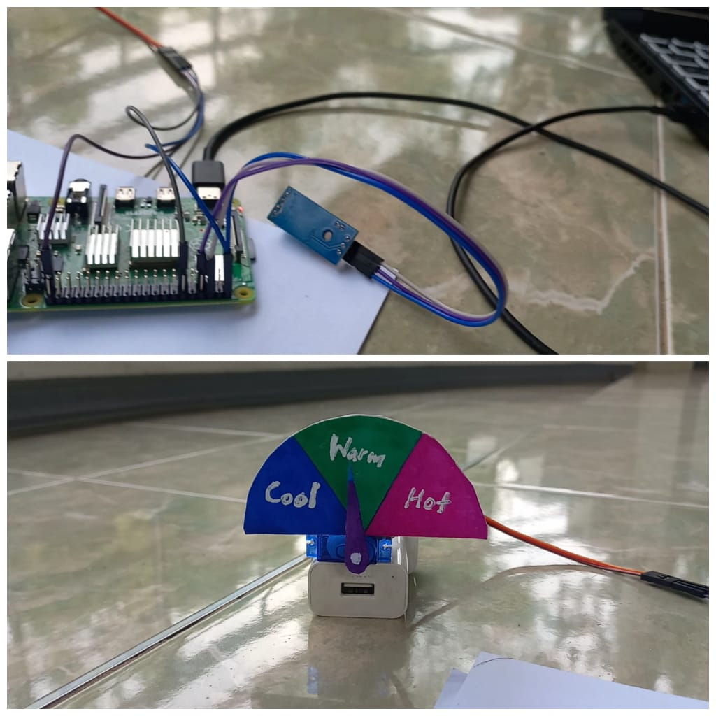
Complete Setup

Slide 6
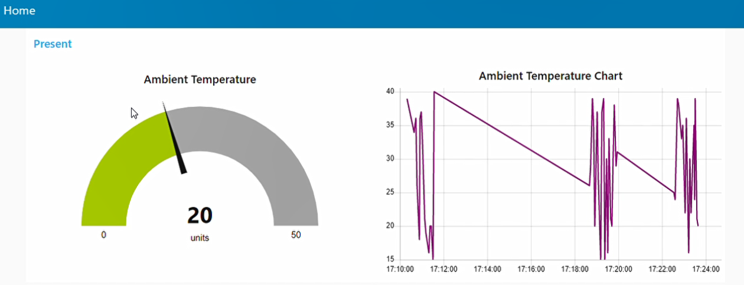
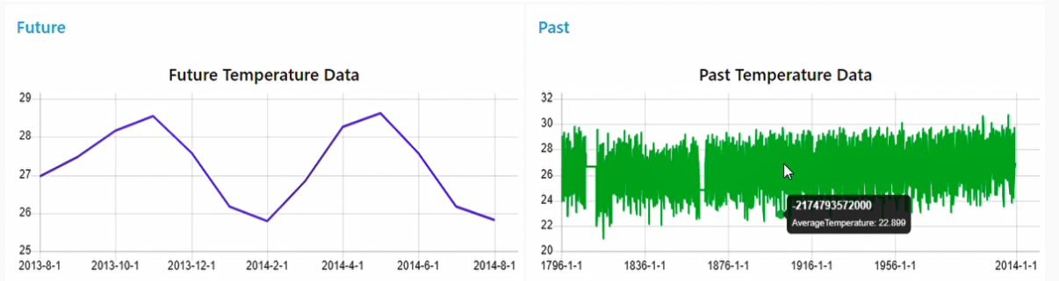
NodeRed Dashboard

Slide 7
Cost Breakdown
Item Name | Cost (LKR)
Raspberry Pi 4 model | 20,500
Enclosure for Raspberry pi | 1,500
Micro SD card class 10 32 GB | 2,500
Temperature sensor | 400
Servo motor | 650
Breadboard | 500
Jumper Wires | 250
Total | 26,300

Slide 8
Contribution
Student ID | Student Name | Component
IT19211824 | H.R.T.V.Indrahenaka | Temperature Prediction
IT19167510 | J.M.S.A.Bandara | Hardware Implementation
IT19157306 | P.A.N.D. Panditharathne | Past data visualization
IT19241906 | W.M.A.B.Wijesinghe | Nodered Dashboard implementation

Slide 9

Thank you!

